Slide 1


Lecture 19
Produced by Dr. Worldwide
Welcome to the 305
~
~

Slide 2


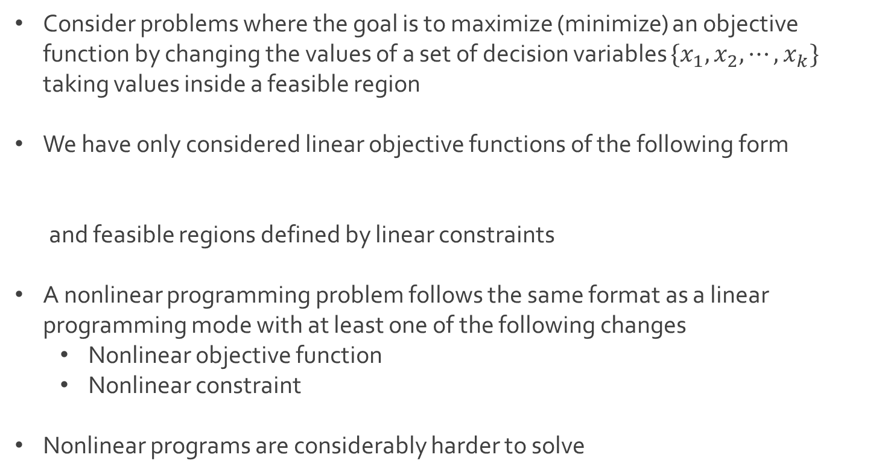
Nonlinear Programming
Consider problems where the goal is to maximize (minimize) an objective function by changing the values of a set of decision variables $\{x_{1}, x_{2},⋯, x_{k}\}$ taking values inside a feasible region
We have only considered linear objective functions of the following form
and feasible regions defined by linear constraints
A nonlinear programming problem follows the same format as a linear programming mode with at least one of the following changes
Nonlinear objective function
Nonlinear constraint
Nonlinear programs are considerably harder to solve
$$c_{1}x_{1}+c_{2}x_{2}+⋯+c_{k}x_{k}$$

Slide 3


Nonlinear Programming
Classic break-even point problem
Consider the profit function
Break-even point is about identifying what choice of $v$ makes $Z=0$
Unrealistic assumption that volume is independent of price
Q: How does demand depend on price?
$$Z=vp−c_{f}−vc_{v}$$
where $v=sales volume (demand)$
$p=price$
$c_{f}=fixed cost$
$c_{v}=variable cost$

Slide 4
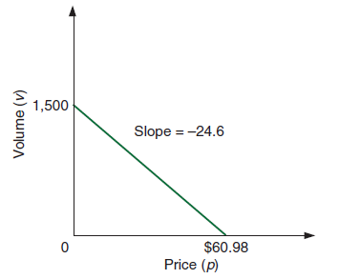
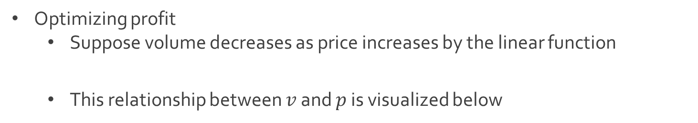
Nonlinear Programming
Optimizing profit
Suppose volume decreases as price increases by the linear function
This relationship between $v$ and $p$ is visualized below
$$v=1500−24.6p$$

Slide 5
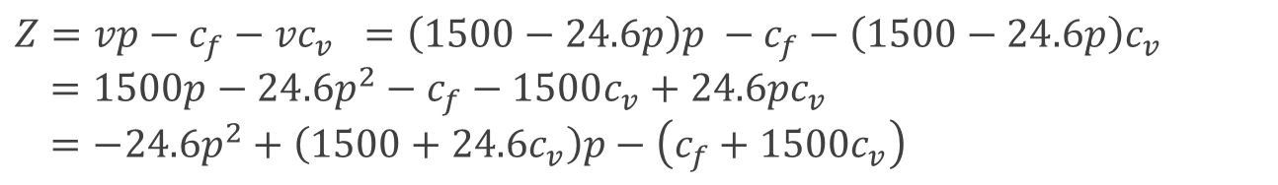

Nonlinear Programming
Optimizing profit
A company may want to know what $p$ maximizes $Z$
Substituting this relation into the profit function
Suppose we know that $c_{f}=\$10,000$ and $c_{v}=\$8$
Q: As price increases, does the profit increase or decrease?
$$Z=vp−c_{f}−vc_{v} =\left(1500−24.6p\right)p −c_{f}−\left(1500−24.6p\right)c_{v}$$
$$=1500p−24.6p^{2}−c_{f}−1500c_{v}+24.6pc_{v}$$
$$=−24.6p^{2}+\left(1500+24.6c_{v}\right)p−\left(c_{f}+1500c_{v}\right)$$
$$Z=−24.6p^{2}+\left(1500+24.6∗8\right)p−\left(10000+1500∗8\right)$$
$$=−24.6p^{2}+1696.8p−22000$$

Slide 6
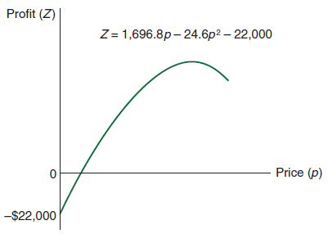
Nonlinear Programming
Optimizing profit
Consider the new nonlinear/quadratic profit curve
Q: How can we find which price maximizes profit?

Slide 7
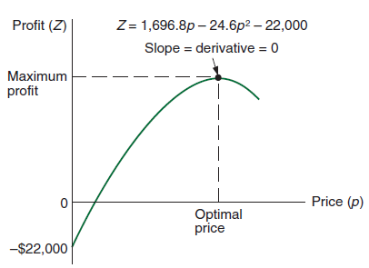
Nonlinear Programming
Optimizing profit
Follow steps from calculus to find the maximum (minimum) of a function
Take the first derivative
Set it equal to zero
Solve for the independent variable
Check second derivative at the point to see if it is a max or min
Negative implies max
Positive implies min

Slide 8

Nonlinear Programming
Optimizing profit
Define function
Derivative of the function based on power rule from Calculus I
Set derivative to zero and solve for the price
Second derivative of the function evaluated at $p^{∗}=34.49$
$$Z=−24.6p^{2}+1696.8p−22000$$
$$Z^{′}=\left(−24.6\right)2p+1696.8=−49.2p+1696.8$$
$$0=−49.2p^{∗}+1696.8 → p^{∗}=\frac{−1696.8}{−49.2}=34.49$$
$$Z^{′′}=−49.2<0 → concave down → minimum$$

Slide 9
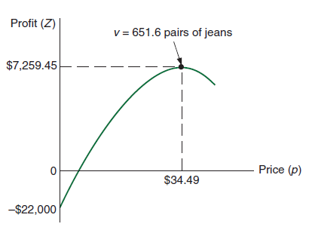
Nonlinear Programming
Optimizing profit
Maximum profit
Expected volume or demand
$$Z=−24.6{\left(34.49\right)}^{2}+1696.8\left(34.49\right)−22000=\$7,259$$
$$v=1500−24.6\left(34.49\right)=651.6$$

Slide 10
Nonlinear Programming
An unconstrained optimization model consists of a single nonlinear objective function without any constraints
When constraints are added, this becomes a constrained optimization model or a nonlinear programming model
Nonlinear programming models are considerably harder to solve since there are no methods guaranteed to find a solution
Q: What about the optimal solution of a nonlinear programming model makes it more difficult to find?

Slide 11
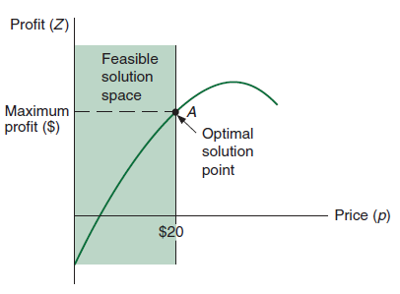

Nonlinear Programming
A price ceiling is a price control, usually determined by the government, designed to protect consumers from conditions that could make commodities ridiculously expensive
Optimizing profit with a price ceiling of $20
Maximize $Z=−24.6p^{2}+1696.8p−22000$
Subject to $0≤p≤20$

Slide 12
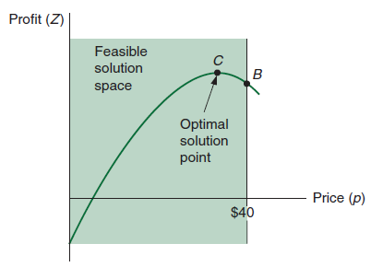

Nonlinear Programming
Optimizing profit with a price ceiling of $40
In a constrained optimization model, it is not guaranteed that optimal solutions lie on the boundary of the feasible region
Maximize $Z=−24.6p^{2}+1696.8p−22000$
Subject to $0≤p≤40$

Slide 13
Solving in Excel
Algorithms for solving nonlinear programming models can be very complex
Most algorithms can only guarantee that they find a local optimizer rather than a global one
Excel Solver uses an algorithm called Generalized Reduced Gradient (GRG) to solve nonlinear problems
This algorithm is designed to find a local optimizer within a certain “tolerance” level, and it can sometimes get “stuck”
In problems not guaranteed to have a unique interior optimal solution, it is a good idea to run the GRG algorithm starting at several initial points

Slide 14
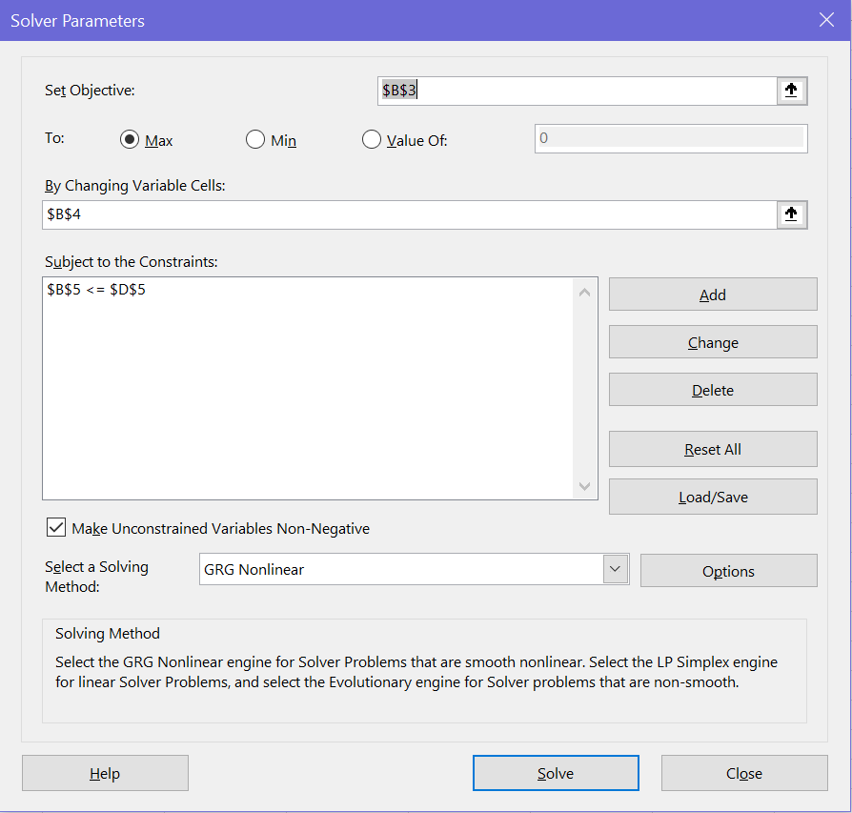
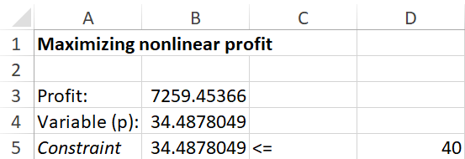
Solving in Excel
Download NonlinearProfit.xlsx from link Sheet 1 on course website
Inspect the spreadsheet and Solver
Solution is for price ceiling of $40
=1696.8*B4-24.6*B4^2-22000

Slide 15
Solving in Excel
Q: What happens if you adjust the price ceiling to $20?
Q: Is your answer consistent with what we have previously seen?
Q: What happens if you completely drop the constraint?

Slide 16




The End
Dale

